Slide 1
Unit 3A
Human Form & Function
Cells, metabolism & regulation
The cell membrane

Slide 2

Study Guide
Read:
Our Human Species
Chapter 3, sections 3.2, 5.1-5.4
Chapter 14, sections 11.3-11.4
Complete:
Workbook
Topic 1 – The Cell Membrane

Slide 3
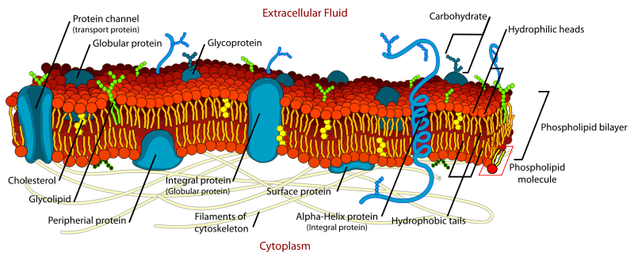
The cell membrane
Drawing by Mariana Ruiz Villarreal

Slide 4
The cell membrane
The cell membrane (or plasma membrane) is the outer boundary of a cell.
The cell membrane is selectively permeable – i.e. it allows some substances to pass through more easily than others.

Slide 5
Structure of the cell membrane
The membrane is a phospholipid bi-layer (i.e. two layers of phospholipid molecules.
The phosphate ‘head’ of the phospholipid molecules are hydrophilic (attracted to water), and form the outer and inner boundaries of the membrane.
The lipid ‘tail’ of the phospholipid molecules are hydrophobic (repelled by water), and form the inner layer of the membrane.

Slide 6
The phospholipid bi-layer also contains the steroid compound cholesterol, which maintains the stability of the membrane.
A variety of protein and carbohydrate molecules are embedded in the membrane.

Slide 7
Functions of the cell membrane
The cell membrane:
Isolates the cell from the surrounding tissue fluid
determines what substances enter and leave the cell
contains a variety of receptors that respond to substances in the cell’s environment e.g. hormones, antigens.

Slide 8
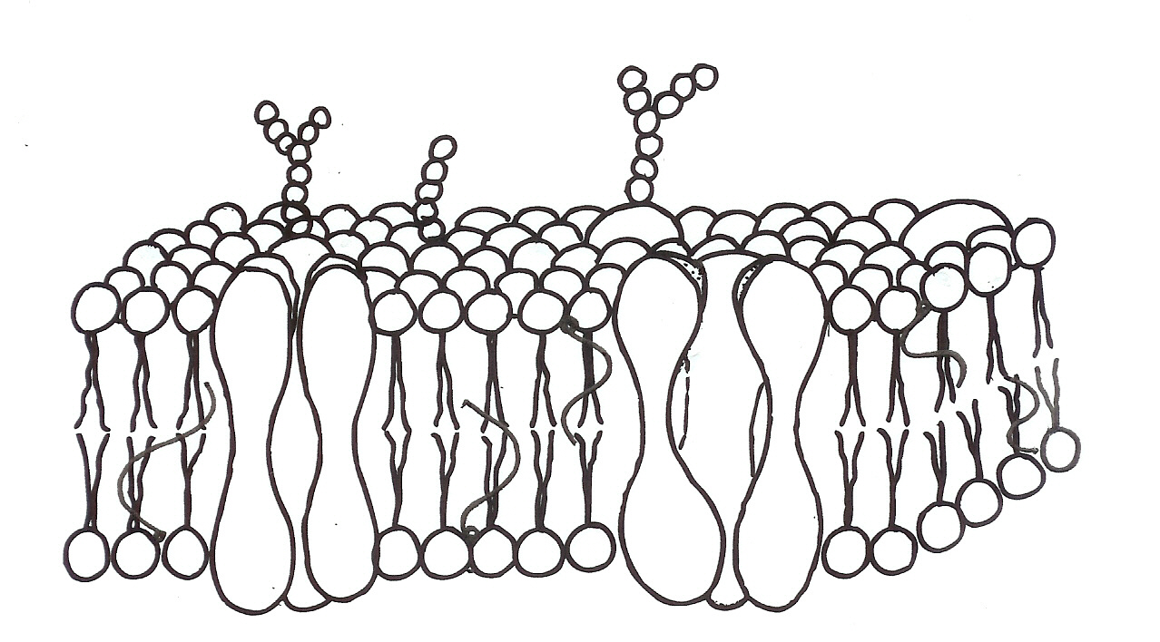
The bi-layer
Membrane protein
Hydrophilic phosphate
TISSUE FLUID
Hydrophobic lipid tail
PHOSPHOLIPID
BI-LAYER
CYTOPLASM

Slide 9
Diffusion through the membrane
Because the cell membrane is fatty, most water soluble substances cannot diffuse through it.
Exceptions include oxygen & carbon dioxide.

Slide 10
Membrane proteins
A variety of proteins are embedded in the bi-layer.
These serve various functions including the movement of substances in and out of the cell.

Slide 11
Membrane transport proteins
Membrane proteins that aid the movement of substances in and out of the cell include:
    Channel proteins (ion channels) –
    open channels that allow simple diffusion.
    Carrier proteins that allow facilitated diffusion (e.g. glucose) and active transport (specific membrane pumps).

Slide 12
Membrane transport
Transport processes are either passive or active.
Passive processes require no cellular energy and include diffusion, osmosis & facilitated diffusion.
Active processes require ATP and include specific membrane pumps and phagocytosis/pinocytosis.

Slide 13
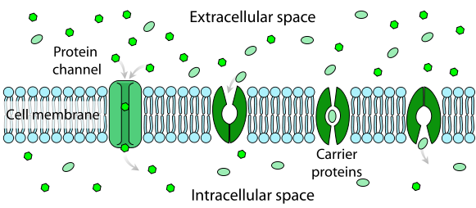
Simple diffusion (left) & facilitated diffusion
Diagram created by LadyofHats

Slide 14
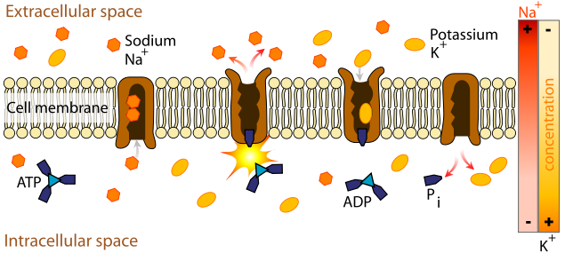
Active transport (sodium pump)
Diagram created by LadyofHats

Slide 15
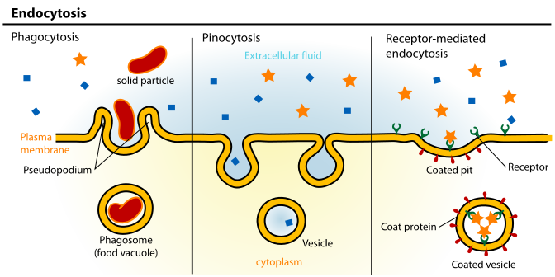
Endocytosis
Diagram created by LadyofHats

Slide 16
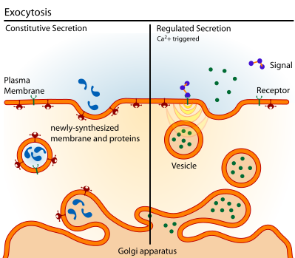
Exocytosis
Diagram created by LadyofHats

Slide 17
Cell markers and receptors
Various protein and carbohydrate molecules exposed on the surface of the membrane:
act as markers – these indicate to cells of the immune system whether a cell is norm or abnormal (see MHC proteins).
serve as receptors that interact with substance in the cell’s environment and initiate specific cellular responses e.g. receptors sensitive to the hormone insulin alter the rate of glucose intake.

